Slide 1
Subscribe to DeepL Pro to edit this document.
Visit www.DeepL.com/pro for more information.

Slide 2
Java Web Services
Intelligent Infrastructure Design for the Internet of Things
Antonio Navarro

Slide 3
Java Web Services
References
Introduction
Publishing and invoking web services
Web Service Broker
Business Delegate
JAX-WS
Introduction
Service Annotations
Customer notes

Slide 4
Java Web Services
JAX-RS
Introduction
Service Annotations
API client
Example
Conclusions

Slide 5
References
Apache CXF User's Guide, http://cxf.apache.org/docs/index.html
Bill Burke, RESTful Java with JAX-RS 2.0, Second Edition, O'Reilly, 2013
B.V. Kumar, P. Narayan, T. Ng, Implementing SOA using Java EE, Addison-Wesley Professional, 2010
Javatips.net, Apache CXF with Jackson, https://www.javatips.net/blog/apache-cxf-with-jackson
JAX-RS: Data Bindings http://cxf.apache.org/docs/jax-rs-data-bindings.html#JAX-RSDataBindings-JSONsupport
Mark D. Hansen, SOA Using Java Web Services, Prentice Hall, 2007
Oracle Java Platform, Enterprise Edition (Java EE) 7, https://docs.oracle.com/javaee/7/index.html

Slide 6
Introduction
Java provides two frameworks to facilitate the implementation of web services:
JAX-WS (Java API for XML Web Services) for SOAP
JAX-RS (Java API for RESTful Web Services) for REST
Development environments make it easy to create web services using Java frameworks
Frameworks need implementations, such as:
Apache CXF (JAX-WS and JAX-RS)
Oracle Metro (JAX-WS)
Oracle Jersey (JAX-RS)
Let's take a look at the main elements of these frames and some simple examples

Slide 7
Publishing and invoking... Web Service Broker
We are going to see a pattern that will help us to expose web services: the Web Service Broker.
Purpose
You want to provide access to one or more services using XML and web protocols
Also known as
Web Services Agent

Slide 8
Publishing and invoking... Web Service Broker
Motivation
Enterprise applications expose their coarse-grained services through service facades, or application services
However, these services may not be ready to be exposed outside the application.
In addition, you may need to compose multiple services to expose them as web services:
Coordinating interactions between one or more services
Adding responses
Demarcating and/or clearing transactions

Slide 9
Publishing and invoking... Web Service Broker
Context
You want to reuse and expose different services to your customers
You want to monitor and potentially limit the use of exposed services, based on business requirements and system resource usage.
Services should be exposed using open standards to enable integration of heterogeneous applications.
You want to bridge the gap between business requirements and existing service capabilities.
Solution
Use a web service broker to expose and negotiate one or more services using XML and web protocols

Slide 10
Publishing and invoking... Web Service Broker
Description
Structure of the web service agent pattern

Slide 11
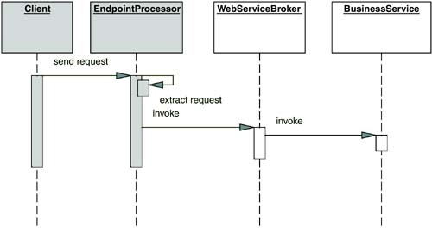
Publishing and invoking... Web Service Broker
Interaction in the web service agent pattern

Slide 12
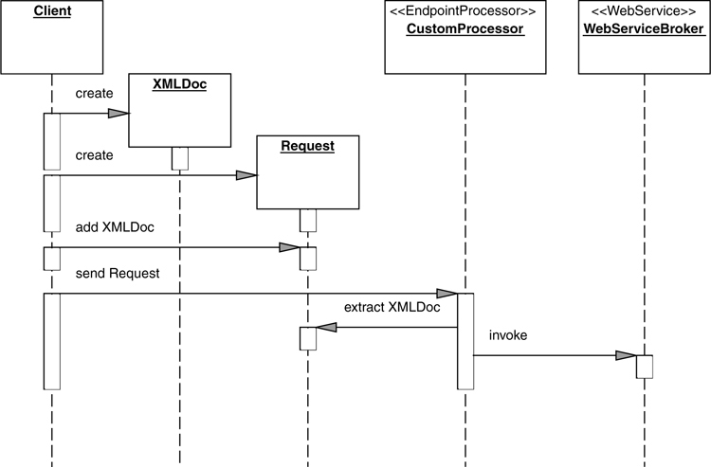
Publishing and invoking... Web Service Broker
Interaction in the web service agent pattern

Slide 13
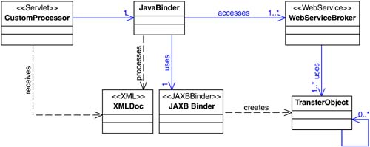
Publishing and invoking... Web Service Broker
RESTful web services pattern structure

Slide 14
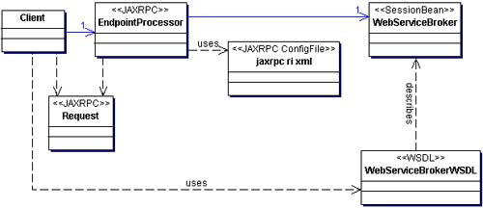
Publishing and invoking... Web Service Broker
Structure of the SOAP web services pattern

Slide 15
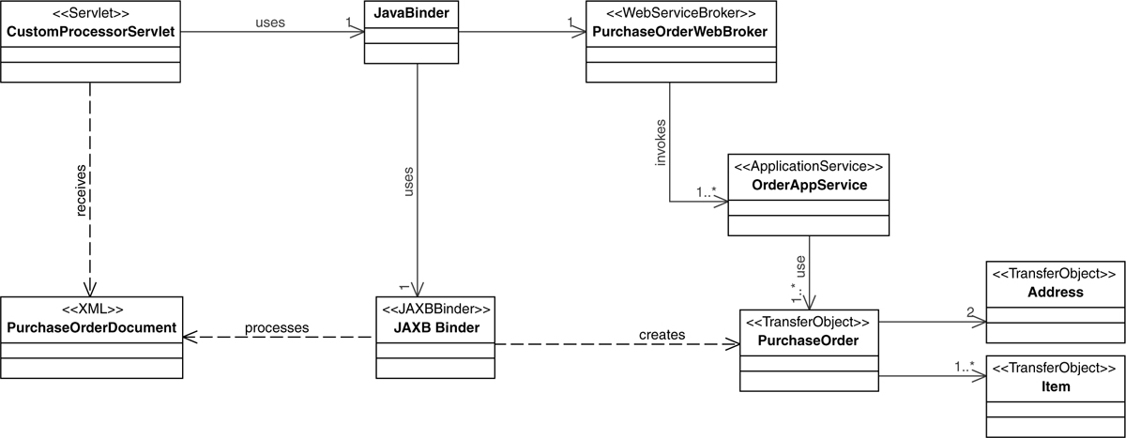
Publishing and invoking... Web Service Broker
RESTful Web Service Agent Example

Slide 16
Publishing and invoking... Web Service Broker
Consequences
Advantages
Introduces a layer between customer and service

Slide 17
Publishing and invoking... Web Service Broker
Example:
@WebService(targetNamespace = "http://wsb.saludo.negocio/", portName = "SaludoWSBPort", serviceName = "SaludoWSBService")
public class SalutationWSB {
public String greet(String first name, String last name)
{
return FactoriaNegocio. getInstancia(). newGreeting().saludar(nombre, apellido);
}

Slide 18
Publishing and invoking... Web Service Broker
public interface Salutation {
public String greet(String first name, String last name);
}
public class SaludoImp implements Saludo {
public String greet(String first name, String last name)
{
return "Hello "+firstname+""+lastname;
}
}

Slide 19
Publication and... Business Delegate
Purpose
Prevents clients from having to deal with distributed component access details in a multi-tier application
Also known as:
Business delegate

Slide 20
Publication and... Business Delegate
Motivation
When customers interact with remote business services, a variety of problems can occur:
Customer and Service Matching
Network performance by multiple invocations
Details of access to the service
Context
You want to access remote business components
You want to minimize the coupling between clients and remote components.
You want to avoid unnecessary remote invocations.

Slide 21
Publication and... Business Delegate
You want to translate network exceptions into application or user exceptions.
You want to hide the details of service creation, reconfiguration and invocation attempts from clients
Solution
Using a business delegate to encapsulate access to remote business services
The business delegate hides business service implementation details, such as search and access mechanisms.

Slide 22
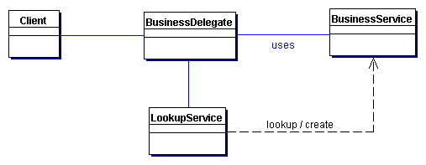
Publication and... Business Delegate
Description
Delegated Business Pattern Structure

Slide 23
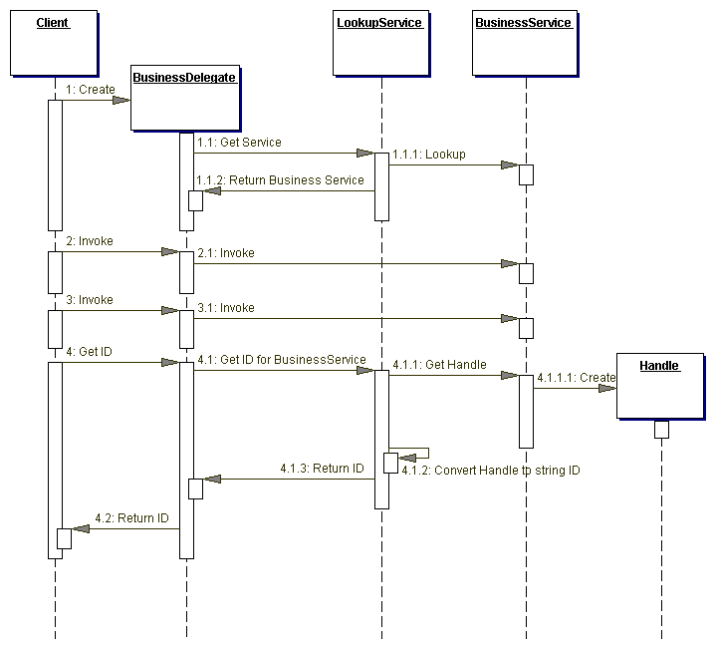
Interaction in the delegated business model

Slide 24
Publication and... Business Delegate
Consequences
Advantages
Reduces coupling, improves modularity
Translates business service exceptions
Improved availability
Exposes a uniform and simpler interface to the business layer
Improved performance
Disadvantages
Enter an additional level
Hide the location of remote services

Slide 25
Publication and... Business Delegate
Example code:
public abstract class DelegateGreeting {
protected static DelegateGreeting instance;
public static DelegateGreeting getInstance()
{
if (instance==null) instance= new DelegateGreetingImp();
return instance;
}
abstract public String greet(String first name, String last name);

Slide 26
Publication and... Business Delegate
public class DelegateGreetingImp extends DelegateGreeting {
protected Saludo port;
public DelegateGreetingImp() {
try {
QName SERVICE_NAME = new QName("http://wsb.saludo.negocio/", "SaludoWSBService");
URL wsdlURL = new URL("http://localhost:8080/saludoSOAP/wsdl/saludowsb.wsdl");
Service ss = Service. create(wsdlURL, SERVICE_NAME);
port= ss.getPort(business.greeting.imp.greeting. class);
} catch (Exception e) {e.printStackTrace(); } } }

Slide 27
Publication and... Business Delegate
public String greet(String first name, String last name)
{
return port.greet(firstname, lastname);
}

Slide 28
JAX-WS. Introduction
JAX-WS makes it easy to define and use web services
Using Java @anotations, automatic tools can publish the WSDL interfaces necessary for their use.
It is used together with JAXB (Java Architecture for XML Bind), which maps Java classes to XML schemas and vice versa.

Slide 29
JAX-WS. Service annotations
On the side that implements the service there are a number of key annotations:
@WebService: indicates the Java class responsible for implementing the web service. It can be used directly on classes or interfaces
@WebMethod: indicates that a Java method is exposed as a web service operation
@WebParam: customize the parameter of a web service method to the corresponding WSDL message part
@WebResult: specifies the mapping of the return type of a web service method
@SOAPBinding: specifies mapping the web service to SOAP message protocol

Slide 30
JAX-WS. Service annotations
Example
@WebService(targetNamespace = "http://wsb.saludo.negocio/", portName = "SaludoWSBPort", serviceName = "SaludoWSBService")
public class SalutationWSB {
public String greet(String first name, String last name)
{
return FactoriaNegocio. getInstancia(). newGreeting().saludar(nombre, apellido);
}
}

Slide 31
JAX-WS. Service annotations
Particularly important are the attributes of @WebService:
name: specifies the name of the service interface (by default, the class name). It is the value of the wsdl:portType attribute in the WSDL contract.
targetNamespace: specifies the namespace
serviceName: specifies the name of the published service. This is the value of the attribute of the wsdl:service element in the WSDL contract.
wsdlLocation: specifies the URI where the WSDL contract is located. By default this is where the service is deployed.
endpointInterface: specifies the name of the Service Endpoint Interface (SEI) that implements the exposed class as a web service (if any).
portName: specifies the name of the end point where the service is published. It is the value of the wsdl:port attribute in the WSDL contract.

Slide 32
JAX-WS. Service annotations
<? xml version="1.0" encoding="UTF-8"?>
< wsdl:definitions name="SalutationWSBService" targetNamespace="http://wsb.saludo.negocio/" xmlns:wsdl="http://schemas.xmlsoap.org/wsdl/" xmlns:tns="http://wsb.saludo.negocio/" xmlns:xsd="http://www.w3.org/2001/XMLSchema" xmlns:soap="http://schemas.xmlsoap.org/wsdl/soap/">

Slide 33
JAX-WS. Service annotations
< wsdl:portType name="SalutationWSB">
< wsdl:operation name="greet">
< wsdl:input name="greet" message="tns:greet">
</wsdl:input>.
< wsdl:output name="greetResponse" message="tns:greetResponse">
</wsdl:output>.
</wsdl:operation>
</wsdl:portType>

Slide 34
JAX-WS. Service annotations
< wsdl:binding name="GreetingWSBServiceSoapBinding" type="tns:GreetingWSB">
< soap:binding style="document" transport="http://schemas.xmlsoap.org/soap/http"/>
< wsdl:operation name="greet">
< soap:operation soapAction="" style="document"/>
< wsdl:input name="greet">
< soap:body use="literal"/>
</wsdl:input>.
< wsdl:output name="greetResponse">
< soap:body use="literal"/>
</wsdl:output>.
</wsdl:operation>
</wsdl:binding>

Slide 35
JAX-WS. Service annotations
......................
< wsdl:service name="SaludoWSBService">
< wsdl:port name="SalutationWSBPort" binding="tns:SalutationWSBServiceSoapBinding">
< soap:address location="http://localhost:8080/saludoSOAP/services/SaludoWSBPort"/>
</wsdl:port>
</wsdl:service>
</wsdl:definitions>

Slide 36
JAX-WS. Service annotations
In CXF the web service publication is declared in the file cxf-beans.xml, which can contain more than one service in a project
<? xml version="1.0" encoding="UTF-8"?>
< beans xmlns="http://www.springframework.org/schema/beans"
xmlns:xsi="http://www.w3.org/2001/XMLSchema-instance"
xmlns:jaxws="http://cxf.apache.org/jaxws"
xsi:schemaLocation=
"http://www.springframework.org/schema/beans
http://www.springframework.org/schema/beans/spring-beans-2.5.xsd
http://cxf.apache.org/jaxws http://cxf.apache.org/schemas/jaxws.xsd">

Slide 37
JAX-WS. Service annotations
<!- If an SEI is used in a different package than the service, CXF puts in xmln:tns the SEI's namespace, instead of the service's, and generate an error in Tomcat -->.
< jaxws:endpoint xmlns:tns="http://wsb.saludo.negocio/"
id="saludowsb"
implementor="business.greeting.wsb.greetingWSB"
wsdlLocation="wsdl/saludowsb.wsdl"
endpointName="tns:SalutationWSBPort".
serviceName="tns:SalutationWSBService"
address="/SalutationWSBPort">
< jaxws:features>
< bean class="org.apache.cxf.feature.LoggingFeature" />
</jaxws:features>
</jaxws:endpoint>.
</beans>

Slide 38
JAX-WS. Service annotations
It is worth discussing whether or not it is necessary to define a Service Endpoint Interface, SEI.
Since the WSDL contract itself plays the role of an interface, it is not necessary to
Perhaps it is more appropriate to define web service in the context of a web service broker.
In any case, if you publish an SEI, you need to publish all its operations. In the case of a class, you do not need to

Slide 39
JAX-WS. Customer notes
On the client side there are also necessary annotations
In this case it is necessary to have an SEI, at least annotated with the values of targetNamepace and name
@WebService(targetNamespace = "http://wsb.saludo.negocio/", name = "SaludoWSB")
public interface Salutation {
public String greet(String first name, String last name);

Slide 40
JAX-WS. Customer notes
Otherwise, we simply need to instantiate the javax.xml.ws.Service class, which is the JAX-WS SOAP access proxy factory.
The proxy needs the access data to the web service implementation, which is provided with an instance of java.xml.namespace.Qname, with the values of the service provider's targetNamespace and serviceName. You also need the access URL to the WSDL contract
This proxy instantiates the SEI defined in the client, from the WSDL contract.

Slide 41
JAX-WS. Customer notes
QName SERVICE_NAME = new QName("http://wsb.saludo.negocio/", "SaludoWSBService");
URL wsdlURL = new URL("http://localhost:8080/saludoSOAP/wsdl/saludowsb.wsdl");
Service ss = Service. create(wsdlURL, SERVICE_NAME);
Greeting port= ss.getPort(main.Greeting. class);
response= port.greet(firstname, lastname);

Slide 42
JAX-RS. Introduction
JAX-RS facilitates both the invocation and response processing of REST web services.
Like JAX-WS, it uses Java @anotations, to generate the REST web service implementation.
It is used together with JAXB (Java Architecture for XML Bind), which maps Java classes to XML schemas and vice versa.

Slide 43
JAX-RS. Service annotations
In this case, there are only annotations on the side that implements the service:
@Path: identifies the template URI that gives access to the service
@xParam: parameters extracted from the URI via patterns
@POST, @GET, @PUT, @DELETE: identify the HTTP access methods, which invoke precisely the methods of the classes they annotate.
@Consumes: MIME media type received by a web service
@Produces: MIME media type produced by a web service

Slide 44
JAX-RS. Service annotations
@Path("/greeting/wsb")
public class SalutationWSB {
@GET
@Path("{firstname}/{lastname}")
@Produces("text/plain")
public String read(@PathParam("firstName") String firstName, @PathParam("lastName") String lastName)
{
return FactoriaNegocio. getInstancia(). nuevoSaludo().saludar(nombre+""+apellido);
}

Slide 45
JAX-RS. Service annotations
The linking of the input URLs with the classes is done through the web.xml file, which can define several services including several servlet definitions (unique name) and several servlet-mapping
<? xml version="1.0" encoding="UTF-8"?>
< web-app xmlns:xsi="http://www.w3.org/2001/XMLSchema-instance"
xmlns="http://java.sun.com/xml/ns/javaee"
xsi:schemaLocation="http://java.sun.com/xml/ns/javaee http://java.sun.com/xml/ns/javaee/web-app_3_0.xsd" version="3.0">

Slide 46
JAX-RS. Service annotations
< servlet>
< servlet-name> CXFServlet</servlet-name>
< servlet-class> org.apache.cxf.jaxrs.servlet.CXFNonSpringJaxrsServlet
</servlet-class>
< init-param>
< param-name> jaxrs.serviceClasses</param-name>.
< param-value>business.greeting.wsb.GreetingWSB</param-value>.
</init-param>
<load-on-startup> 1</load-on-startup>.
</servlet>

Slide 47
JAX-RS. Service annotations
< servlet-mapping>
< servlet-name> CXFServlet</servlet-name>
< url-pattern> /services/*</url-pattern>
</servlet-mapping>.
</web-app>

Slide 48
JAX-RS. Service annotations
JAX-RS is quite flexible with respect to the @Path annotation, so the following annotations correspond to the same URL:
http://localhost:8080/saludoREST/servicios/saludo/wsb/Charlton/Heston
@Path("/greeting/wsb")
public class SalutationWSB {
@GET
@Path("/{firstname}/{lastname}") ..............................
@Path("/greeting/wsb")
public class SalutationWSB {
@GET
@Path("{firstname}/{lastname}") ..............................

Slide 49
JAX-RS. Service annotations
It is worth mentioning that JAX-RS can manage different types of parameters:
@PathParam: patterns identified in the URL. For example, http://localhost:8080/saludoREST/servicios/saludo/wsb/Charlton/Heston
MatrixParam: value name pairs in the URL, preceded by ";". For example, http://servidor.es/producto/crear/27;active=false
@QueryParam: traditional parameters in URLs. For example: http://localhost:8080/saludoREST/saludo/wsb?nombre=Miguel&apellido=Ríos
@FormParam: parameters coming from forms

Slide 50
JAX-RS. Service annotations
@HeaderParam: parameters included in the HTTP header
@CookieParam: parameters included in cookies
@BeanParam: classes built automatically from parameters. For example,
Public class CustomerInput {
@FormParam("first")
String firstName;
@FormParam("last")
String lastName;
@HeaderParam("Content-Type")
StringContentType;
public String getFirstName() { return firstName, }
…………….. }

Slide 51
JAX-RS. Service annotations
@Path("/customers")
public class CustomerResource {
@POST
public void createCustomer(@BeanParam CustomerInput newCust) { ........}
…………………………………………………….
}

Slide 52
JAX-RS. Service annotations
The service can also receive information in XML or JSON format, which:
It can be sent directly in these formats
It can come from objects that can be serialized to those formats with additional frames such as:
JAXB for XML
JSON-B for JSON
You have to configure CXF with a cxf.xml file as it says (Javatips.net)
(JAX-RS Data Bindings) also gives more information about it

Slide 53
JAX-RS. Client API
JAX-RS makes client-side invocation quite easy thanks to the API provided by
There are several key classes:
ClientBuider: API entry point when creating Client instances
Client: API entry point for constructing and executing client requests and for consuming the returned responses
WebTarget: target resource identified by URL
Invocation.Builder: the client request builder. It is the one that sends GET, POST, PUT, DELETE requests.
Response: response provided by GET, POST, PUT, DELETE invocation. Can be translated directly to other types supported by Entity
Entity: information sent in request and obtained in response. For example: APPLICATION_JSON, APPLICATION_SVG_XML, APPLICATION_XML, TEXT_HTML, TEXT_PLAIN

Slide 54
JAX-RS. Client API
For example:
String url= "http://localhost:8080/saludoREST/servicios/saludo/wsb";
Client client = ClientBuilder. newClient();
String res= client.target(url + "/Charlton/Heston").request().get(String. class);
System. out.println(res);
client.close();

Slide 55
JAX-RS. Client API
The get(), post(), put() and delete() methods of Invocation.Builder return a Response.
In the example above, the client can directly consume a String, because the methods allow you to set the response type to a different one (the framework handles the conversion from the Response type to the specified one).

Slide 56
JAX-RS. Example
Let's look at a simple example involving all four methods
Let's look at it by invocation/service pairs:
String url= "http://localhost:8080/saludoREST/servicios/saludo/wsb";
Client client = ClientBuilder. newClient();
String res= client.target(url + "/Charlton/Heston").request().get(String. class);
System. out.println(res);

Slide 57
JAX-RS. Example
@Path("/greeting/wsb")
public class SalutationWSB {
@GET
@Path("{firstname}/{lastname}")
@Produces("text/plain")
public String read(@PathParam("firstName") String firstName, @PathParam("lastName") String lastName)
{
return FactoriaNegocio. getInstancia(). nuevoSaludo().saludar(nombre+""+apellido);
}

Slide 58
JAX-RS. Example
res= client.target(url). request().post(Entity. text("Gwyneth, Paltrow"), String. class);
System. out.println(res);
@POST
public Response readPOST(String s)
{ List<String> l = Arrays. asList(s.split("\s*,\s*"));
String name= l.get(0);
String lastname= l.get(1);
String res= FactoriaNegocio. getInstancia(). nuevoSaludo().saludar(nombre+" " +apellido+"-POST");
return Response. ok(res). build();

Slide 59
JAX-RS. Example
res= client.target(url + "?firstname=Miguel&lastname=Rios"). request(). delete(String. class);
System. out.println(res);
@DELETE
@Produces("text/plain")
public String readDELETE(@QueryParam("firstName") String firstName, @QueryParam("lastName") String lastName)
{
return FactoriaNegocio. getInstancia(). nuevoSaludo().saludar(nombre+""+apellido+"-DELETE");

Slide 60
JAX-RS. Example
Form form= new Form();
form.param("name", "Melania");
form.param("last name", "Trump");
res= client.target(url).request().put(Entity. form(form), String. class);
System. out.println(res);

Slide 61
JAX-RS. Example
@PUT
public String readPUT(@FormParam("firstName") String firstName, @FormParam("lastName") String lastName)
{
String res= FactoriaNegocio. getInstancia(). nuevoSaludo().saludar(nombre+" " +apellido+"-PUT");
return res;

Slide 62
JAX-RS. Example
Client client2 = ClientBuilder. newClient(). register(org.eclipse.yasson.JsonBindingProvider. class);
String url2= "http://localhost:8080/saludoREST/servicios/saludo/wsb/json";
Persona p= new Persona("Pepe", "Romero");
Greeting s= client2.target(url2). request(MediaType. APPLICATION_JSON)
. put(Entity.json(p), Greeting. class);
System. out.println(s.getText());

Slide 63
JAX-RS. Example
@XmlRootElement
public class Person {
protected String name;
protected String last name;
…………….. }
@XmlRootElement
public class Salutation {
String text;
…….. }

Slide 64
JAX-RS. Example
@PUT
@Path("/json")
@Consumes(MediaType. APPLICATION_JSON)
@Produces(MediaType. APPLICATION_JSON)
public Greeting readPUTjson(Person p)
{
Greeting s= new Greeting();
s.setText(BusinessFactory. getInstance(). newGreeting().greeting(p.getFirstName()+" " +p.getLastName()+"-PUTjson"));
return s;

Slide 65
Conclusions
JAX-WS and JAX-RS make it much easier to implement Java web services.
JAX-WS is quite convenient when used in conjunction with the IDE
Which one is better? I don't know
Which one is simpler? I don't know, but JAX-WS has been seen in 14 slides and JAX-RS in 23 slides.

Slide 66
Java Web Services
Intelligent Infrastructure Design for the Internet of Things
Antonio Navarro

